Slide 1
64-Bits
R. Timothy Tomaselli
February 3, 2014

Slide 2
PRE-Z/ARCHITECTURE
24 bits
32 bits
31 bits
ESA
Multiple 2G Address Spaces
AR (logically) points to Segment Table
L 3,16(,7)
L 3,16(7)
L 3, 16(4,7)
GPR
Paired AR

Slide 3
WHY 64 BITS OF ADDRESS SPACE?
FORTRAN

Slide 4
REGISTER NOMENCLATURE
bits are still numbered left-to-right - 0 to 63
G[rande] is the name for 64-bit quantities
H
L
HH HL LH LL
0
15
16
31
32
47
48
63

Slide 5
REGISTER NOMENCLATURE (cont.)
OILF, OIHF - the 32-bit immediate ORs
OIHH , OIHL, OILH, OILL - the four 16-bit immediate ORs
Finally - register TEST UNDER MASK
TM, TMY
TMHH, TMHL, TMLH, TMLL, TMH, TML

Slide 6
The Lowly ADD Instruction
A - just like the old days
AR - also like the old days
AH - still like the old days
AG - 64-bit add with 20-bit signed displacement
AGR - 64-bit RR add
AGF - 64-bit + 32-bit = 64-bit add with 20-bit signed displacement
AGFR - 64-bit + 32-bit = 64-bit RR add
AY - 32-bit add with 20-bit signed displacement
AHY - 16-bit add with 20-bit signed displacement
ARK - 32-bit RRR add
AGRK - 64-bit RRR add
AGHI - 64-bit + 16-bit = 64-bit
AFI - 32-bit immediate
AGFI - 64-bit + 32-bit immediate = 64-bit
AHIK - 32-bit + 32-bit + 16-bit signed immediate
AGIK - 64-bit + 64-bit + 16-bit signed immediate
ASI - 32-bit + 8-bits interlocked storage add with 20-bit signed displacement
AGSI - 64-bit + 8-bit interlocked storage add with 20-bit signed displacement

Slide 7
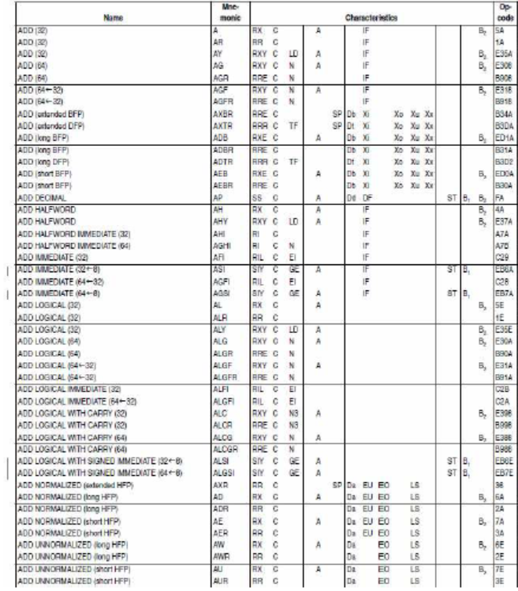

Slide 8
NO MORE BASE REGISTERS !!
well, sort of
relative branch instructions added
all the old conditionals [BH ==> BRH, BE ==> BRE, etc]
various branch-and-save
BCT, BXLE, BXH
execute
beware of unconditional branch - B ==> BR TROUBLE
BRU is relative unconditional branch
displacement is signed 16-bit halfword amount
also a long form where displacement is signed 32-bit halfword amount

Slide 9
NO MORE BASE REGISTERS (cont.)
loads, stores & compares - long signed displacements
load address relative - long only - half-words
but beware putting data and instructions too close together...

Slide 10
Branch Prediction
branch hints
BPP and BPRP - branch prediction preload
4-bit code describes target branch
length, call, return, neither

Slide 11
MORE ABOUT INSTRUCTION CHANGES
full IEEE binary floating point
full IEEE decimal floating point
moves, compares, searches for C-style strings
many many more control program instructions
a slew of security/encryption-related instructions
conditional LOAD/STORE
STGE R1,X'8',FRED
finally! SLR+IC = LLGC
LB/LBG - loads and sign-extends a byte

Slide 12
EVEN MORE ABOUT INSTRUCTION CHANGES
Translate now has four forms:
byte to byte
byte to half-word
half-word to byte
half-word to half-word
collection of load/compare-and-trap-style instructions
OI/NI/XI atomic !!
load multiple disjoint - R1,R3,D2(B2),D4(B4) loads 0..31 from D2(B2) into R1..R3; then 32..63

Slide 13
STILL MORE ABOUT INSTRUCTION CHANGES
conversions among UTF-8, 16, 32
ASCII character and digit
multiply (20) - 64/64, 64/32, "single", immediate, 64-bit logical
divide (10) - 64/64, 64/32, "single", 64-bit logical
load reversed - 2, 4, 8 bytes - endian conversion

Slide 14
AND EVEN MORE ABOUT INSTRUCTION CHANGES
compare and swap and store - D1(B1),D2(B2),R3
R3 contains many mode bits
GR0, GR1 contain lengths and parameter list address
NIAI - Next Instruction Access Intent
PFD - Pre-fetch / Castout Data
ECAG – Extract CPU Attributes

Slide 15
32 GPRs – REALLY??
Many instructions duplicate 32-bit operations but instead use bits 0..31
leaving 32..63 untouched
ADD HIGH
ADD IMMEDIATE HIGH
ADD LOGICAL HIGH
ADD LOGICAL WITH SIGNED IMMEDIATE HIGH
BRANCH RELATIVE ON COUNT HIGH
COMPARE HIGH
COMPARE IMMEDIATE HIGH
COMPARE LOGICAL HIGH
COMPARE LOGICAL IMMEDIATE HIGH
LOAD BYTE HIGH
LOAD HALFWORD HIGH
LOAD HIGH
LOAD LOGICAL CHARACTER HIGH
LOAD LOGICAL HALFWORD HIGH
ROTATE THEN INSERT SELECTED BITS HIGH
ROTATE THEN INSERT SELECTED BITS LOW
STORE CHARACTER HIGH
STORE HALFWORD HIGH
SUBTRACT HIGH
SUBTRACT LOGICAL HIGH

Slide 16
KEWL BIT-HANDLING INSTRUCTIONS
FLORG R1,R2
if P1[bit 60] then set P2[bit 63]
LG R2,P1
RISBG[Z] R3,R2,63,63,60-63
STG R3,P2
RISBG[Z] R1,R2,I3,I4,I5
ROSBG[T]
RNSBG[T]
RXSBG[T]
rotate R2's value by fifth operand; + ==> left / -- ==> right
select bit range from third & fourth operands; wrap-around works!
perform logical operation with R1 target
T-variant just sets condition code
POPCNT R1,R2

Slide 17
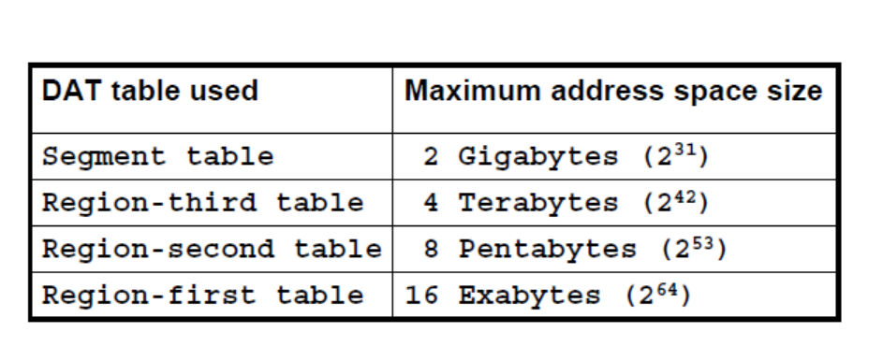
ADDRESS SPACE SIZES

Slide 18
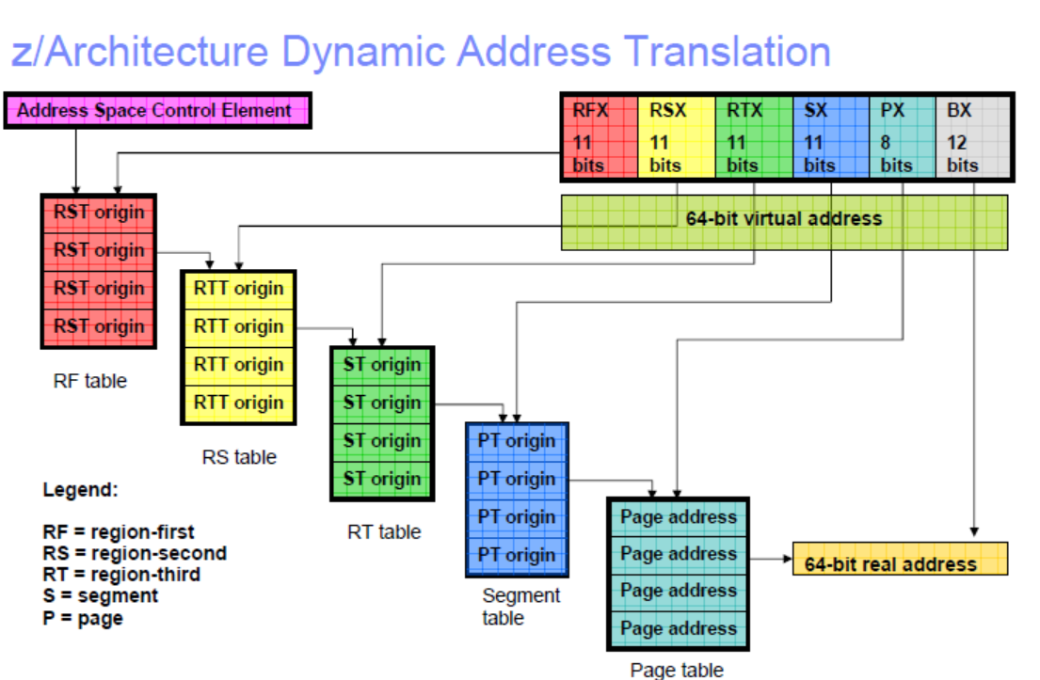
BASIC ADDRESS TRANSLATION

Slide 19
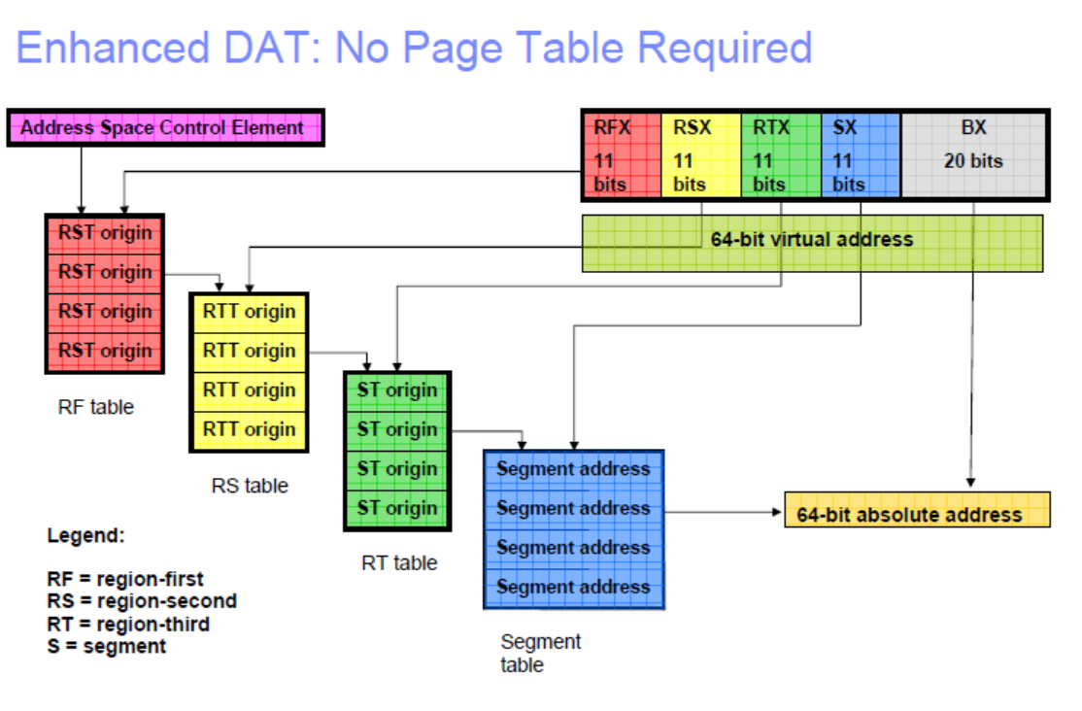
“BIG PAGE” TRANSLATION

Slide 20
TRANSACTION FACILITY
multiple nested transactions
the transactional-execution facility provides the means by which a program can issue multiple instructions, the storage-operand accesses of which appear to occur as a single concurrent operation as observed by other CPUs and by the channel subsystem.
begin/commit protocol
constrained and non-constrained flavors
reduced instruction set
limited number of instructions deep

Slide 21
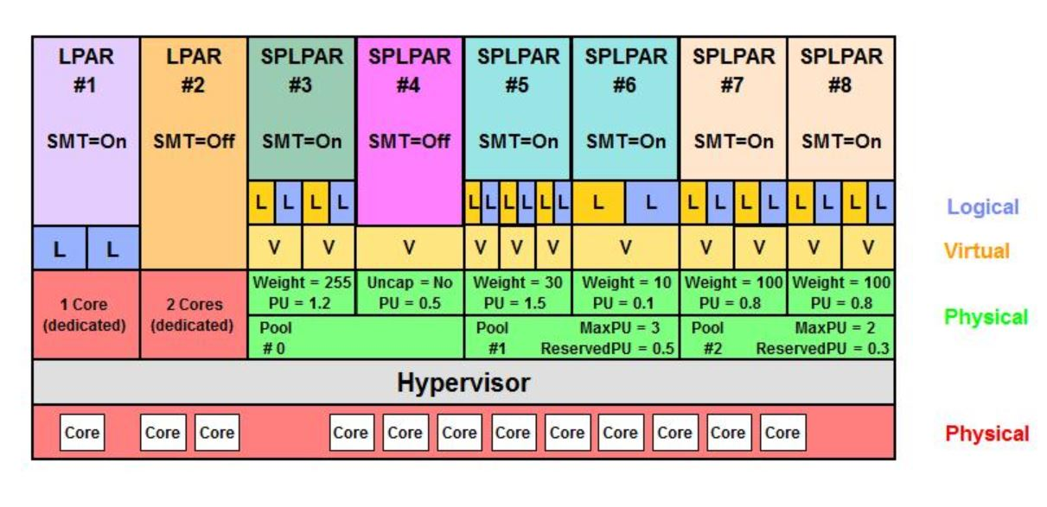
THIS IS NOT Z/LPAR

Slide 22
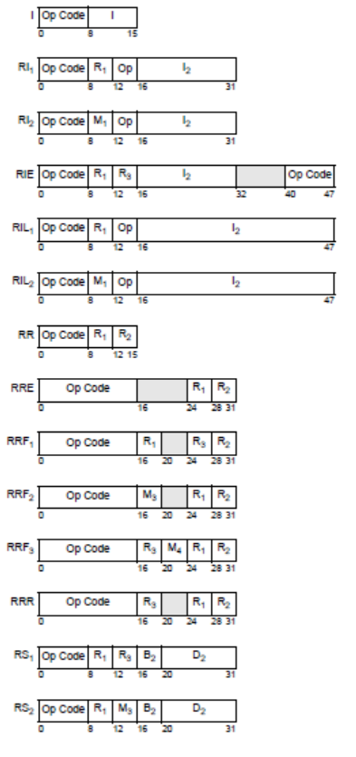
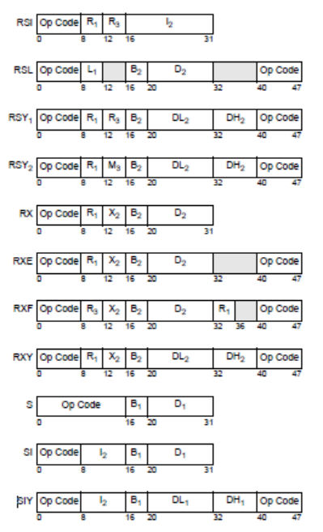
FORMATS

Slide 23
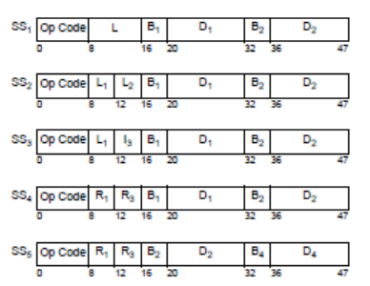
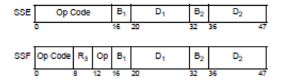
FORMATS

Slide 24
FINALLY …
The Green Card is now 82 pages

